Slide 1
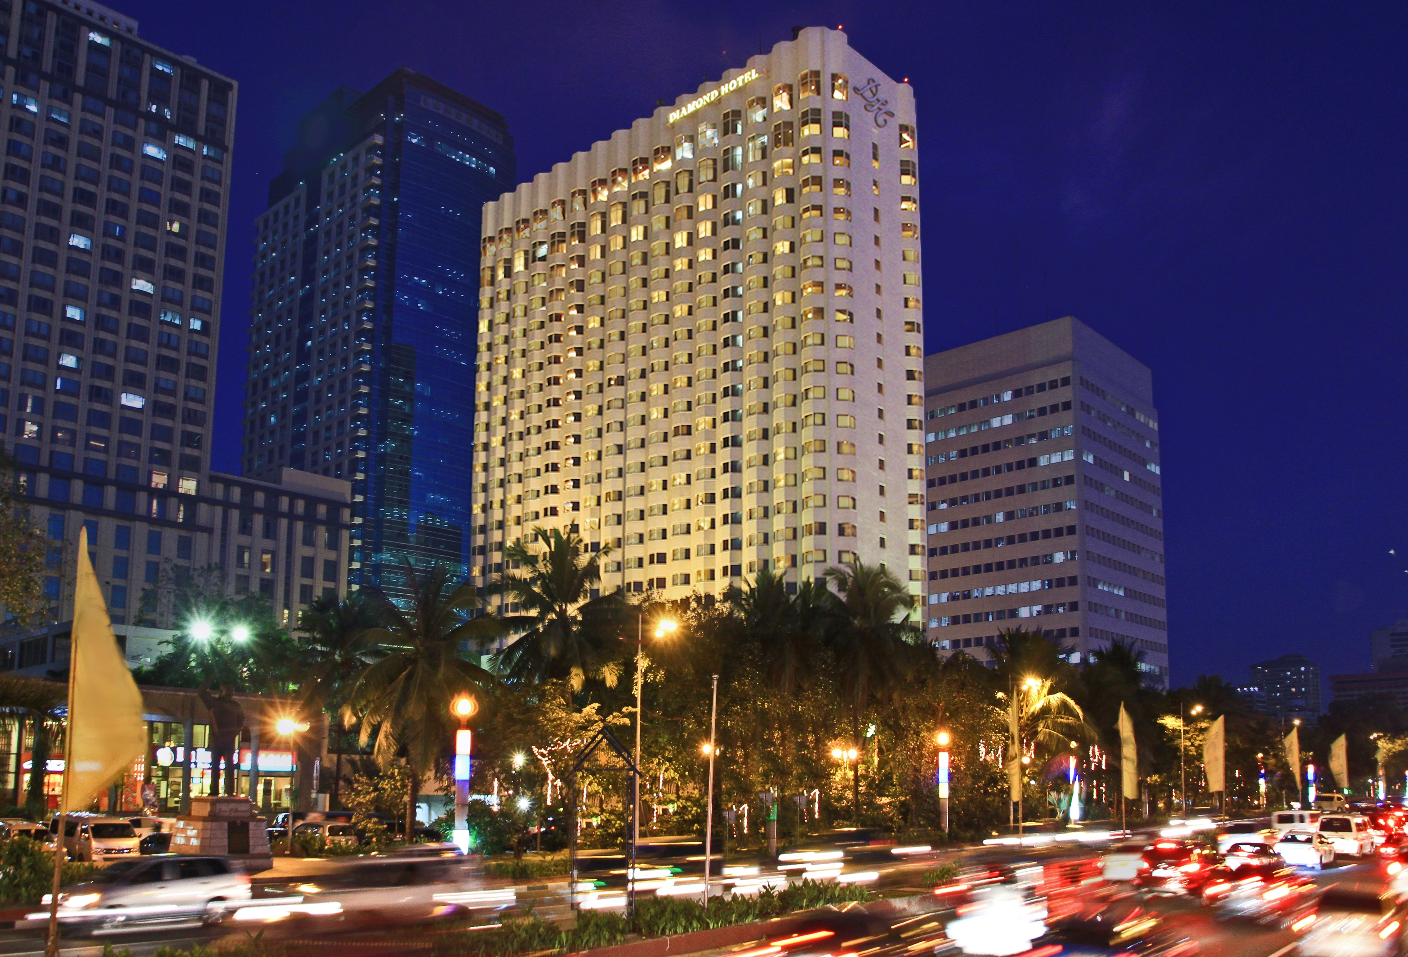
HOTEL RESERVATION ANALYSIS
(USING SQL)

Slide 2




01
DATA COLLECTION The first step is to collect data and store it in any type of file like .csv, .json, .xlsx, .txt, .xml, etc
02
UPLOADING DATA
The collected data should be uploaded into an SQL database or an RDBMS to facilitate the analysis.
STEPS INVOLVED
04
DATA ANALYSIS Cleaned Data is then analyzed to extract valuable insights and derive business metrics
03
DATA CLEANING
The process involves correcting errors, handling missing values, and standardizing formats.

Slide 3
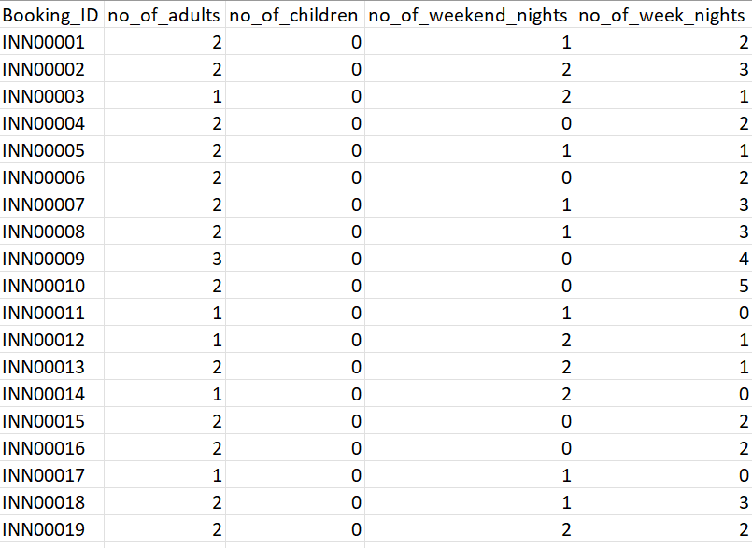
DATA COLLECTION
About the Dataset:
The given dataset is in.csv format
The dataset includes the following columns:
Booking_ID: A unique identifier for each hotel reservation.
no_of_adults: The number of adults in the reservation.
no_of_children: The number of children in the reservation.
no_of_weekend_nights: The number of nights in the reservation that fall on weekends.
no_of_week_nights: The number of nights in the reservation that fall on weekdays.
type_of_meal_plan: The meal plan chosen by the guests.
room_type_reserved: The type of room reserved by the guests.
lead_time: The number of days between booking and arrival.
arrival_date: The date of arrival.
market_segment_type: The market segment to which the reservation belongs.
avg_price_per_room: The average price per room in the reservation.
booking_status: The status of the booking.

Slide 4
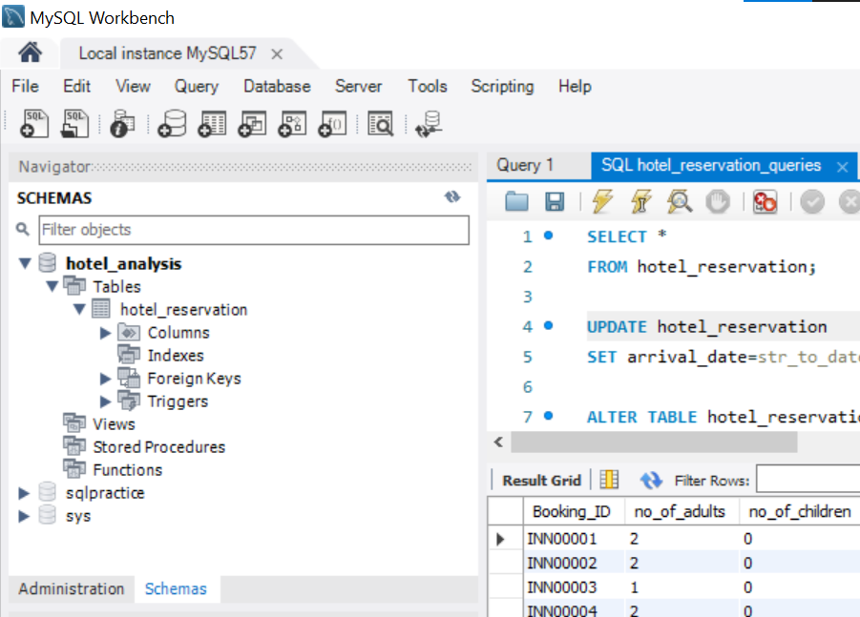
UPLOADING DATA
Used my SQL workbench
Uploaded .csv file into it
Created hotel_reservation table to analyze the given data set

Slide 5
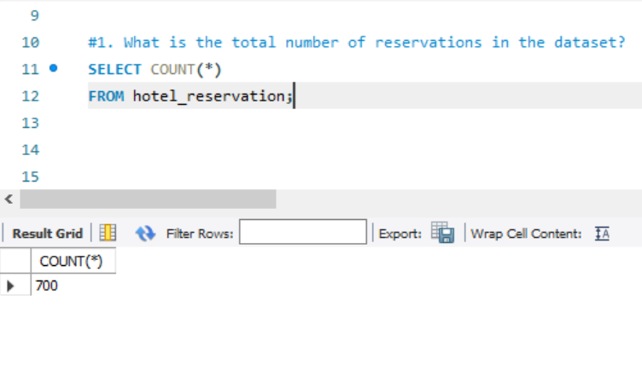
1. What is the total number of reservations in the dataset?
Ans. There are 700 total reservations

Slide 6
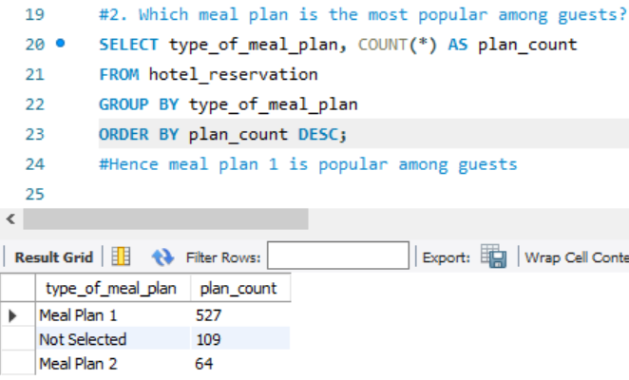
2. Which meal plan is the most popular among guests?
Ans. Meal plan 1 is the most popular among guests

Slide 7
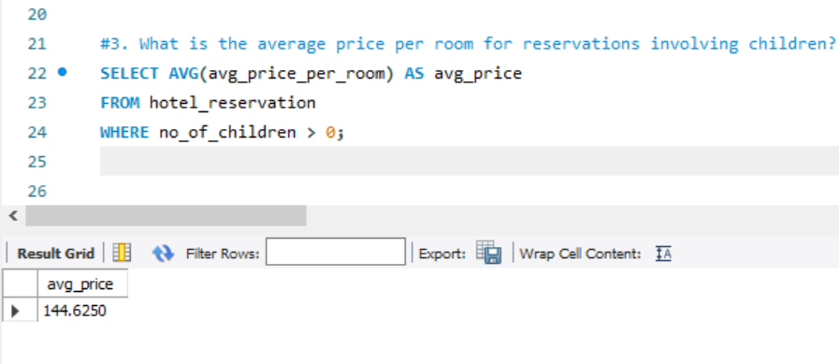
3. What is the average price per room for reservations involving children?
Ans. The average price per room for reservations involving children is 144.6

Slide 8
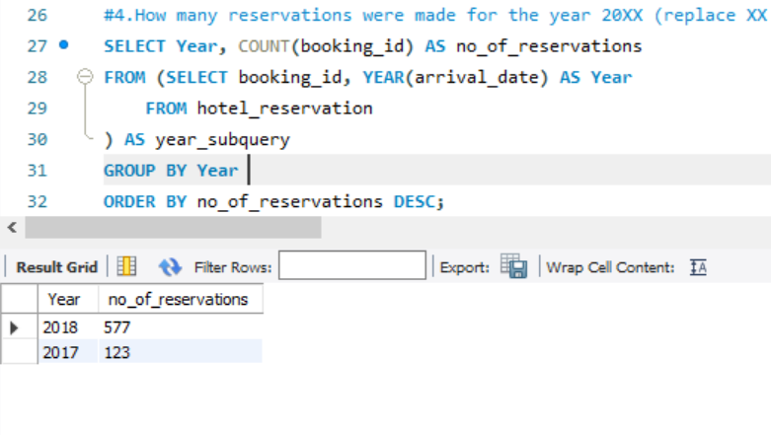
4. How many reservations were made for the year 20XX (replace XX with the desired year)?
Ans. In the year 2017- 123 reservations and for the year 2018- 577 reservations were made

Slide 9
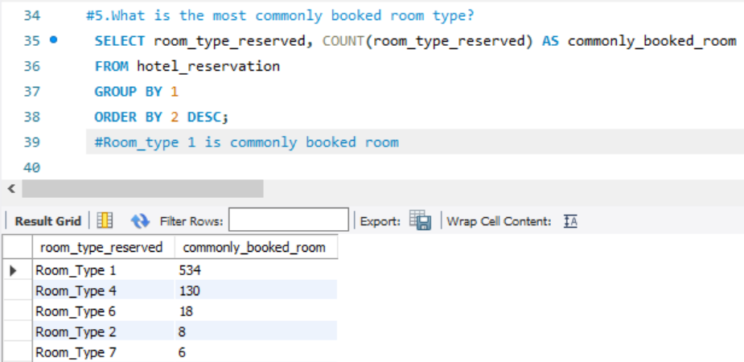
5. What is the most commonly booked room type?
Ans. Room Type 1 is the most commonly booked room

Slide 10
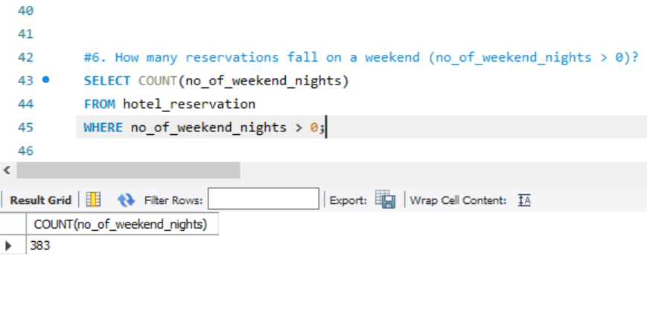
6. How many reservations fall on a weekend (no_of_weekend_nights > 0)?
Ans. 383 reservations

Slide 11
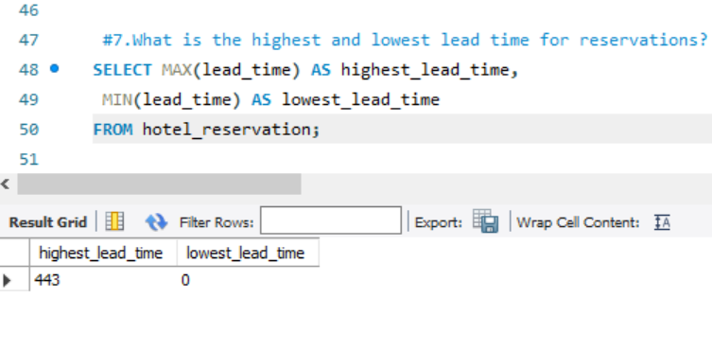
7. What is the highest and lowest lead time for reservations?
Ans. The highest lead time is 443 and lowest lead time is 0

Slide 12
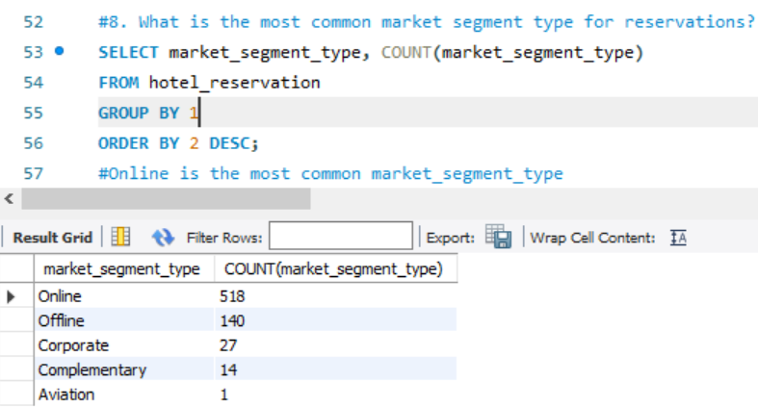
8. What is the most common market segment type for reservations?
Ans. Online is the most common market segment type for reservations

Slide 13
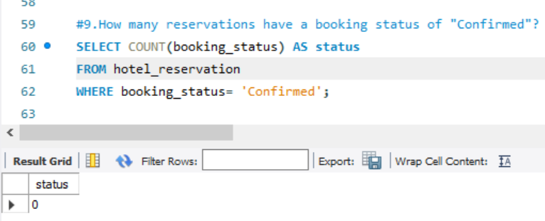
9. How many reservations have a booking status of "Confirmed"?
Ans. There are no reservations which are having booking status as “Confirmed”

Slide 14
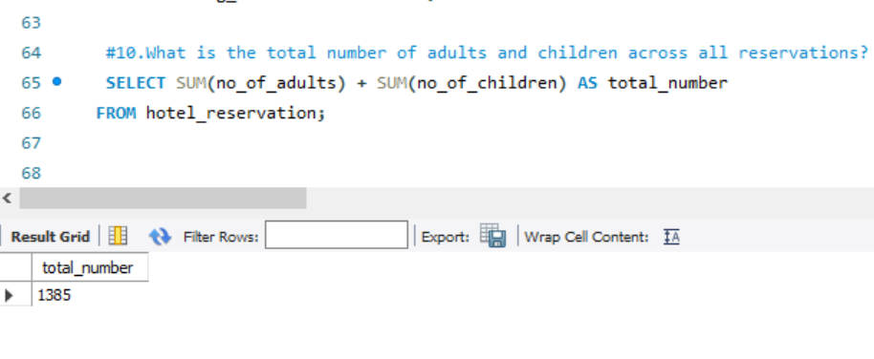
10. What is the total number of adults and children across all reservations?
Ans. The total number of adults and children across all reservations is 1385.

Slide 15
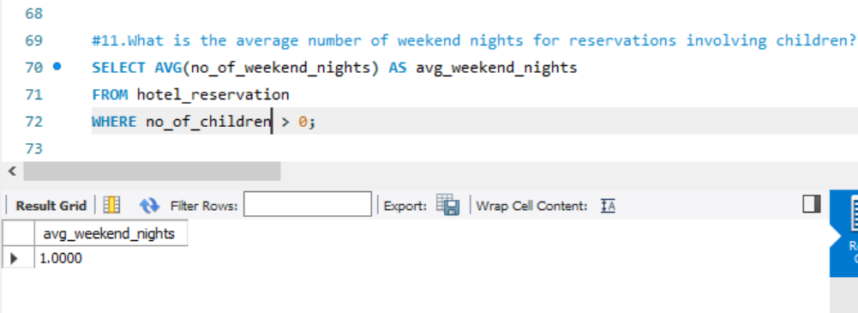
11. What is the average number of weekend nights for reservations involving children?
Ans. The average number of weekend nights for reservations involving children is 1.

Slide 16
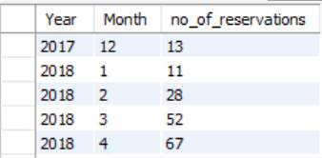
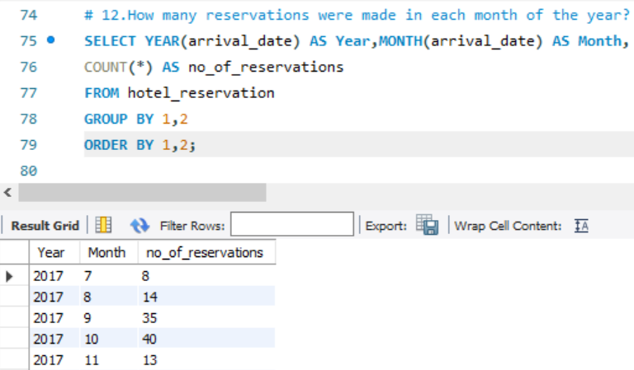
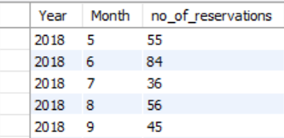
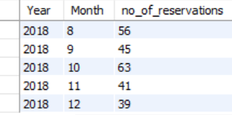
12. How many reservations were made in each month of the year?
Ans. These are the reservations made in each month of the year

Slide 17
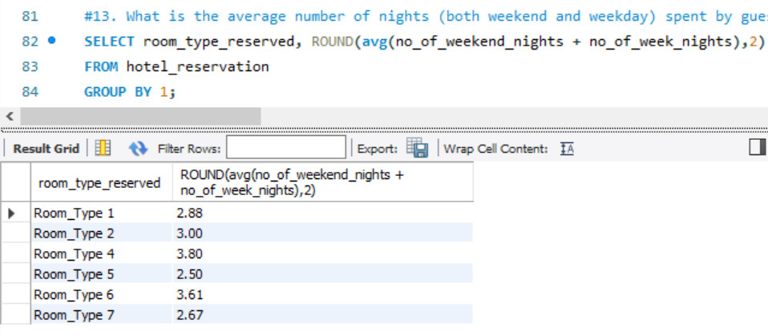
13. What is the average number of nights (both weekend and weekday) spent by guests for each room type?
Ans. The average number of nights for each room type is
Room Type 1: 2
Room Type 2: 3
Room Type 4: 3
Room Type 5: 2
Room Type 6: 3
Room Type 7: 2

Slide 18
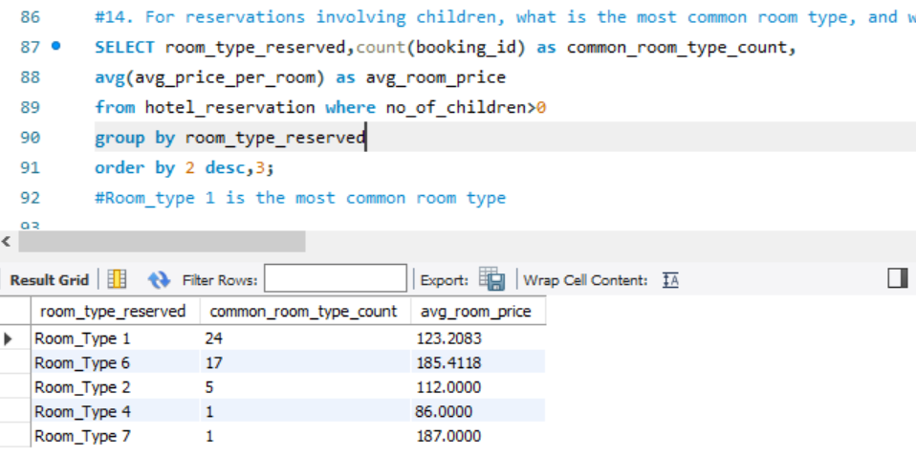
14. For reservations involving children, what is the most common room type, and what is the average price for that room type?
Ans. The most common room type is 1 and the average room price of that room type is 123.2

Slide 19
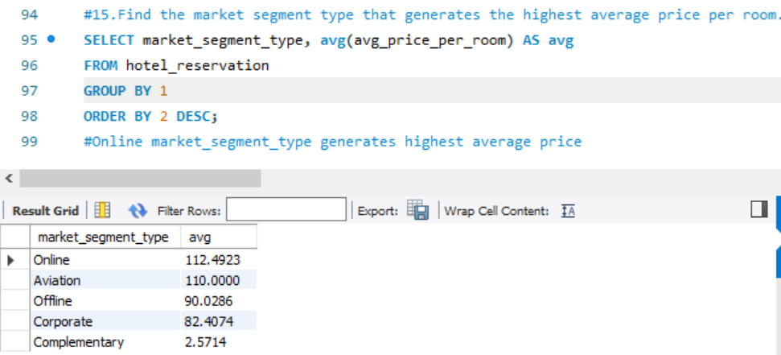
15. Find the market segment type that generates the highest average price per room.
Ans. The online market segment type is the one that generates the highest average room price per room of 112.49

Slide 20
SUMMARY
Hotel Reservation Analysis Project
This hotel reservation analysis project aims to deliver actionable insights to optimize various facets of hotel management.
By analyzing booking patterns, customer demographics, revenue streams, and occupancy rates, we seek to maximize revenue, enhance guest experiences, and improve operational efficiency.
Tailoring Offerings: Increase guest satisfaction by personalizing services and amenities.
Streamlining Operations: Enhance resource allocation and operational efficiency.
Market Analysis: Gain a competitive edge through comprehensive market insights.
Data-Driven Decisions: Empower hotel management with data-informed strategies.
The ultimate goal is to provide hotel management with the knowledge and tools needed to excel in the competitive and dynamic hospitality industry.

Slide 21


